Slide 1
CIS 4526 Foundations of Machine Learning
Chapter 9
Bayesian Classifier

Slide 2

Sheldon Cooper is our guest lecturer today

Slide 3

Conditional Probability
The conditional probability of an event B is the probability that the event will occur given the knowledge that an event A has already occurred. This probability is written as P(B|A), referred as Probability of B given A
If events A and B are not independent, then the probability of the intersection of A and B (the probability that both events occur) is defined by
P($\text{A} ∩ \text{B}$) = P(A) P(B|A)
P($\text{A} ∩ \text{B}$)
Or P(B|A) = ---------------
P(A)

Slide 4
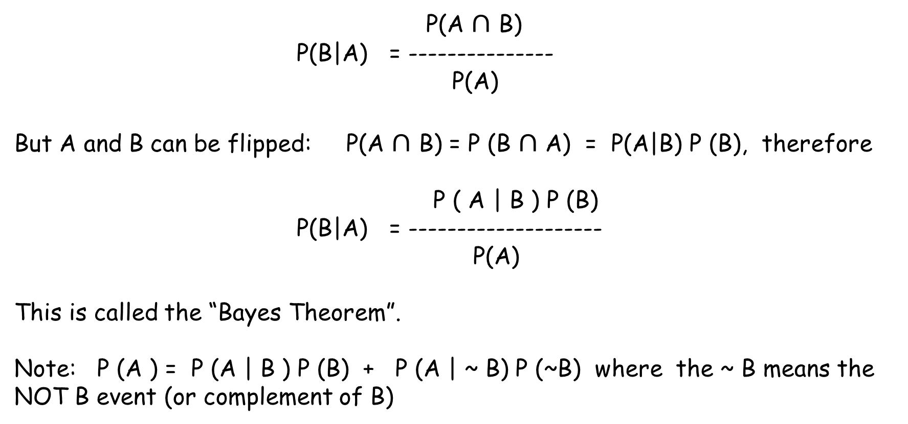
Bayes Theorem
P(A $∩$ B)
P(B|A) = ---------------
P(A)
But A and B can be flipped: P(A $∩$ B) = P (B $∩$ A) = P(A|B) P (B), therefore
P ( A | B ) P (B)
P(B|A) = --------------------
P(A)
This is called the “Bayes Theorem”.
Note: P (A ) = P (A | B ) P (B) + P (A | ~ B) P (~B) where the ~ B means the NOT B event (or complement of B)

Slide 5
Bayes Theorem
Question:
1% of women have breast cancer (and therefore 99% do not).
80% of mammograms detect breast cancer when it is there (and therefore 20% miss it, i.e., 20% false negative).
10.0% of mammograms detect breast cancer when it’s not there (and therefore 90% correctly return a negative result and 10% false positive ).
What is the probability that the woman does have cancer if she is tested positive?
Solution:
Let A = Test Positive, B = Has Cancer, so we want to calculate
P ( B | A)
Given P (B ) = 1%, P( A | B ) = 80%, P (A | ~B) = 10%

Slide 6
Bayes Theorem
A = Test Positive, B = Has Cancer
Given P (B ) = 1%, P( A | B ) = 80%, P (A | ~B) = 10%
P ( A | B ) P (B)
P(B|A) = ---------------------------------------------------
P(A|B) P(B) + P (A | ~ B) P (~ B)
P( Positive | Cancer ) P (Cancer)
P (Cancer| Positive ) = --------------------------------- ----------------------------------
P( Positive | Cancer) P(Cancer) + P(Positive | No Cancer) P (No Cancer)
80% * 1 %
= ---------------------------------------------------- = 7.5%
80 % * 1 % + 10% * 99%

Slide 7
Bayes Theorem
A positive mammogram only means you have a 7. 5% chance of cancer, rather than 80% (the supposed accuracy of the test).
It might seem strange at first, but it makes sense: the test gives a false positive 10% of the time (quite high), so there will be many false positives in a given population. For a rare disease, most of the positive test results will be wrong.
Let’s test our intuition by drawing a conclusion from simply eyeballing the table.
If you take 100 people, only 1 person will have cancer (1%), and they’re most likely going to test positive (80% chance).
Of the 99-remaining people, about 10% will test positive, so we’ll get roughly 10 false positives.
Considering all the positive tests, just 1 in 11 is correct, so there’s a 1/11 chance of having cancer given a positive test. The real number is 7.5% (closer to 1/13, computed above), but we found a reasonable estimate without a calculator.

Slide 8
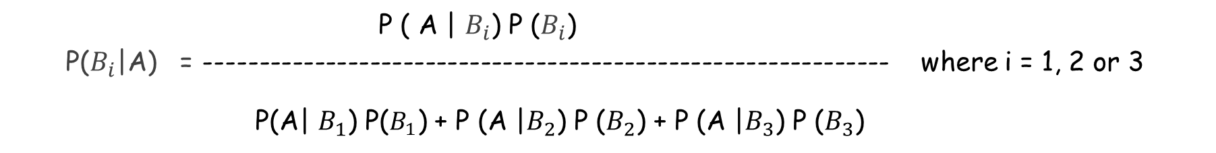
More General Bayes Theorem
P(A|B) P(B) P ( A | B ) P (B)
P(B|A) = ------------------ = ------------------------------------
P(A) P(A|B) P(B) + P (A | ~ B) P (~ B)
Because there are only 2 cases:
B and ~B
More generally, if the event B can be partitioned into 3 cases $B_{1},B_{2}, B_{3}$, then
P ( A | $B_{i}$) P ($B_{i}$)
P($B_{i}$|A) = -------------------------------------------------------------- where i = 1, 2 or 3
P(A| $B_{1}$) P($B_{1}$) + P (A |$B_{2}$) P ($B_{2}$) + P (A |$B_{3}$) P ($B_{3}$)

Slide 9
Naïve Bayes Classifier
How could we use Bayes theorem in Machine Learning?
The idea is in supervised learning, we know P( data | class label) from the training set,
What we need in predicting new data is in fact P( class label | data ).
So, we can use Bayes theorem:
P ( observed data for each class)
P(class label on given observed data) = ----------------------------------------------------
P ( observed data )

Slide 10
Bayesian Spam Filtering
Example: Classify whether an email is Spam or not
Class label: Spam or Not Spam (Ham)
Data: Words inside the message
P ( words | spam ) P (spam )
P( spam | words ) = -----------------------------------------------
P (words)
We will come back to this after we cover Natural Language Processing
Let’s get back to the general Naïve Bayes Classifier

Slide 11



Mathematics behind Naïve Bayes Classifier
P ( features | label) P (label)
P( label | features ) = --------------------------------------------------
P (features)
Remember we usually denote the label by y, the features are $x_{1},x_{2},…, x_{n}$
We have
Make the naïve assumption that the features random variables are independent, i.e.

Slide 12

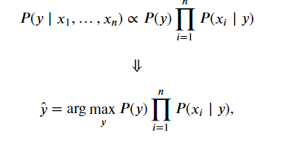
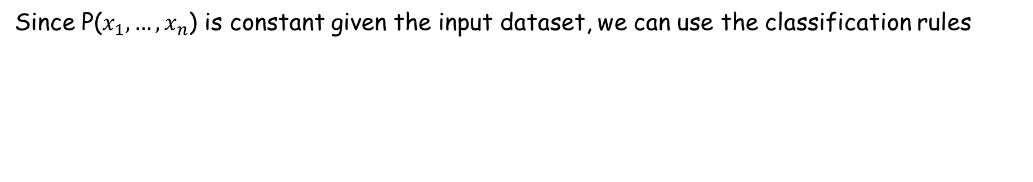
Mathematics behind Naïve Bayes Classifier
We have
Since P($x_{1},…, x_{n}$) is constant given the input dataset, we can use the classification rules
That is, we predict y by choosing the class that maximize the A Posteriori (MAP) distribution ( P (y | x ) )

Slide 13
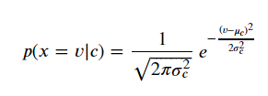
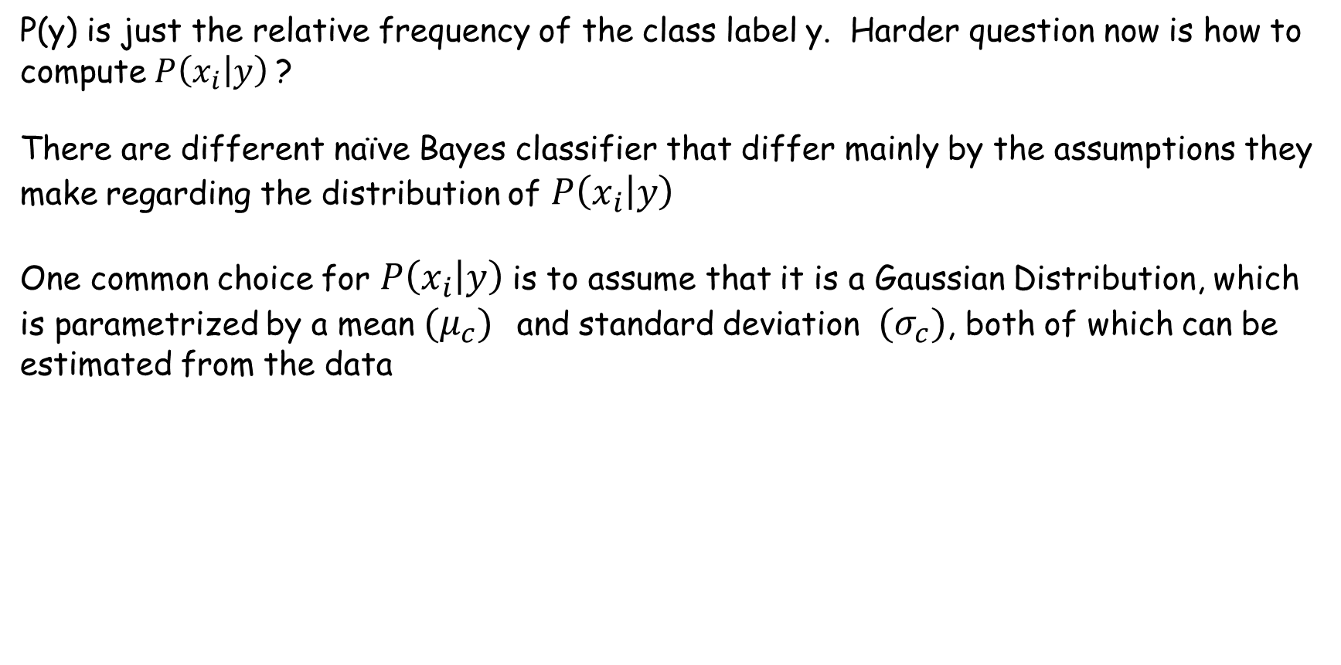
Mathematics behind Naïve Bayes Classifier
P(y) is just the relative frequency of the class label y. Harder question now is how to compute $P\left(x_{i} | y\right)$?
There are different naïve Bayes classifier that differ mainly by the assumptions they make regarding the distribution of $P\left(x_{i} | y\right)$
One common choice for $P\left(x_{i} | y\right)$is to assume that it is a Gaussian Distribution, which is parametrized by a mean ${(μ}_{c})$ and standard deviation ${(σ}_{c})$, both of which can be estimated from the data

Slide 14
Naïve Bayes Classifier
Learning by doing
https://www.youtube.com/watch?v=U_85TaXbeIo

